Slide 1
Subject:
Object-oriented analysis and design
Chapter 4: Object-Oriented Design Process
M.Sc. Lê Văn Vinh
Department of Software Engineering
Faculty of Information Technology
University of Technical Education HCMC
Source: Nguyễn Trần Thi Văn ‘s lecture

Slide 2
Contents
From problem to code
The Object and Class Concepts
Identifying Classes
Identifying Responsibilities
Relationships Between Classes
Use Cases
CRC Cards
UML Diagrams
Notes:
Lecturer: Nguyễn Trần Thi Văn
Software Development Environments and Tools

Slide 3
Objectives
After the lesson, you will be able to:
  Tell the major jobs in system design using Object-Oriented method.
  Identify system classes and their responsibilities.
  Give the names and functions of major UML diagrams used in the design phase.

Slide 4
From problem to code
Three Phases:
  Analysis
  Design
  Implementation
Case Study: Course Registration System

Slide 5
Analysis Phase
Functional Specification:
  Completely defines tasks to be solved
  Free from internal contradictions
  Readable both by domain experts and software developers
  Reviewable by diverse interested parties
  Testable against reality

Slide 6
Design Phase
Goals:
  Identify classes
  Identify behavior of classes
  Identify relationships among classes

Slide 7
Design Phase
Artifacts:
  Textual description of classes and key methods
  Diagrams of class relationships
  Diagrams of important usage scenarios
  State diagrams for objects with rich states

Slide 8
Implementation Phase
Implement and test classes
Combine classes into program
Avoid "big bang" integration
Prototypes can be very useful

Slide 9
Object and Class concept
Object: Three characteristic concepts
  State
  Behavior
  Identity
Class: Collection of similar objects

Slide 10
Identifying classes
Rule of thumb: Look for nouns in problem description
Focus on concepts, not implementation.
Ex: Student, Course, Schedule, Professor, etc.

Slide 11
Categories of Classes
  Tangible Things
  Agents
  Events and Transactions
  Users and Roles
  Systems
  System interfaces and devices
  Foundational Classes

Slide 12
Finding Classes Guidelines
  A class should capture one and only one key abstraction
  Bad abstraction: Student class which knows the student information and the student schedule for the current semester
  Good abstraction: Separate classes for Student and Student Schedule
Notes:
Lecturer: Nguyễn Trần Thi Văn
Software Development Environments and Tools

Slide 13
Naming Classes
  A class name should be a singular noun that best characterizes the abstraction
  Difficulty in naming a class may be an indication of a poorly defined abstraction
  Names should come directly from the vocabulary of the domain
Notes:
Lecturer: Nguyễn Trần Thi Văn
Software Development Environments and Tools

Slide 14
Style Guide for Naming Classes
  A style guide should dictate naming conventions for classes
  Sample style guide
    Classes are named using singular nouns
    Class names start with an upper case letter
    Underscores are not used
      Names composed of multiple words are pushed together and the first letter of each additional word is capitalized
    Example: Student, Professor, BillingSystem
Notes:
Lecturer: Nguyễn Trần Thi Văn
Software Development Environments and Tools

Slide 15
Identifying responsibilities
Rule of thumb: Look for verbs in problem description
Behavior of class Course:
  Add a student in to the course
  Remove a student from course
  Check course’s capacity
  etc.

Slide 16
Identifying responsibilities
OO Principle: Every operation is the responsibility of a single class
Example: Add a Student to Course
Who is responsible: Student or Course?

Slide 17
Class relationships
Dependency (“uses”)
Association (“uses”)
Aggregation (“has”)
Composition (“has”)
Inheritance (“is”)

Slide 18
Multiplicities
1 : 1 or 1 : 0...1 relationship:
public class Mailbox
{
. . .
private Greeting myGreeting;
}
1 : n relationship:
public class MessageQueue
{
. . .
private ArrayList<Message> elements;
}

Slide 19
Use cases
Analysis technique
Each use case focuses on a specific scenario
Use case = sequence of actions
Action = interaction between actor and computer system
Each action yields a result
Each result has a value to one of the actors
Use variations for exceptional situations

Slide 20
Sources of Information for Use Cases
  System specifications/problem statement
  Domain relevant literature
  Interviews with domain experts
  Personal knowledge of the domain
  Legacy systems
Notes:
Lecturer: Nguyễn Trần Thi Văn
Software Development Environments and Tools

Slide 21
Finding Use Cases: Useful Questions
    What are the tasks of this actor?
    Will the actor create, store, change, remove or read information in the system?
    What use case will create, store, change, remove, or read, this information?
    Will the actor need to inform the system about sudden, external changes?
    Does the actor need to be informed about certain occurrences in the system?
    Does the system supply the business with the correct behavior?
    What use cases will support and maintain the system?
    Can all functional requirements be performed by the use cases?
Notes:
Lecturer: Nguyễn Trần Thi Văn
Software Development Environments and Tools

Slide 22
CRC cards
CRC = Classes, Responsibilities, Collaborators
Developed by Beck and Cunningham
Use an index card for each class
Class name on top of card
Responsibilities on left
Collaborators on right

Slide 23
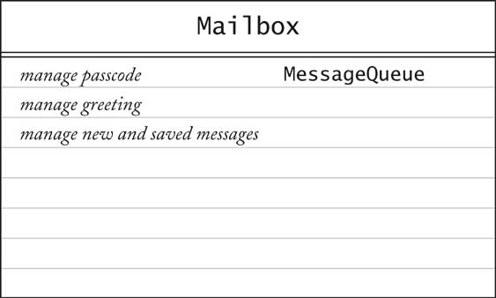
CRC cards

Slide 24
CRC cards
Responsibilities should be high level
1 - 3 responsibilities per card
Collaborators are for the class, not for each responsibility.

Slide 25
UML diagrams
There are many types of diagrams in UML
3 main diagrams used in design phase:
  Class diagram
  Sequence diagram
  State diagram

Slide 26
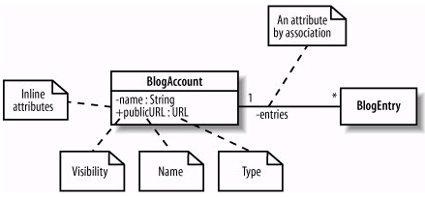
Class diagrams
  Rectangle with class name
  Optional compartments: Attributes, Methods
  Include only key attributes and methods

Slide 27
Class diagrams
In a class diagram, there are also:
  Relationships between classes
  Multiplicities of relationships
  (more details in SDEs)

Slide 28
Sequence diagrams
A sequence diagram shows object interactions arranged in time sequence
The diagram shows:
  The objects participating in the interaction
  The sequence of messages exchanged
A sequence diagram contains:
  Objects with their “lifelines”
  Messages exchanged between objects in ordered sequence.

Slide 29
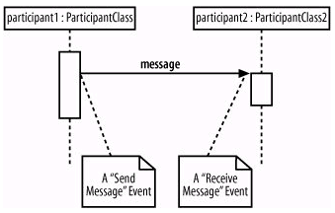
Sequence diagrams

Slide 30
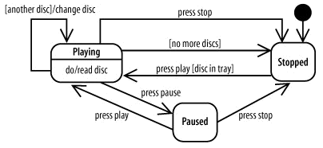
State diagrams
Used for classes whose objects have interesting states.

Slide 31
Chapter’s summary
Class and object are the key concepts in OOD
A use case describes one system’s function
Class diagrams are used to model system’s structure.
Sequence diagrams are used to model interaction between objects in the system
State diagrams show objects’ states and transition flow between these states

